Slide 1


Computer Applications to Behavioral Sciences
Lecture 17. Web development Deployment
https://psychology-courses.appspot.com/
Dr. Jibo He
Wichita State University
hejibo@gmail.com

Slide 2
Overview
Google Application Engine (GAE)
Setup GAE environment
Sign up (GAE)
Deploy your website in GAE

Slide 3

Google Application Engine (GAE)
Does one thing well: running web apps
Simple app configuration
Scalable
Secure

Slide 4
App Engine Does One Thing Well
App Engine handles HTTP(S) requests, nothing else
Think RPC: request in, processing, response out
Works well for the web and AJAX; also for other services
App configuration is dead simple
No performance tuning needed
Everything is built to scale
“infinite” number of apps, requests/sec, storage capacity
APIs are simple, stupid

Slide 5
App Engine Architecture
req/resp
stateless APIs
R/O FS
urlfech
Python
VM
process
stdlib
mail
app
images
datastore
stateful
APIs
memcache
*

Slide 6

Why Not LAMP?
Linux, Apache, MySQL/PostgreSQL, Python/Perl/PHP/Ruby
LAMP is the industry standard
But management is a hassle:
Configuration, tuning
Backup and recovery, disk space management
Hardware failures, system crashes
Software updates, security patches
Log rotation, cron jobs, and much more
Redesign needed once your database exceeds one box
“We carry pagers so you don’t have to”
FREE

Slide 7
Setup GAE environment
Download and install
https://storage.googleapis.com/appengine-sdks/featured/GoogleAppEngine-1.9.14.msi

Slide 8
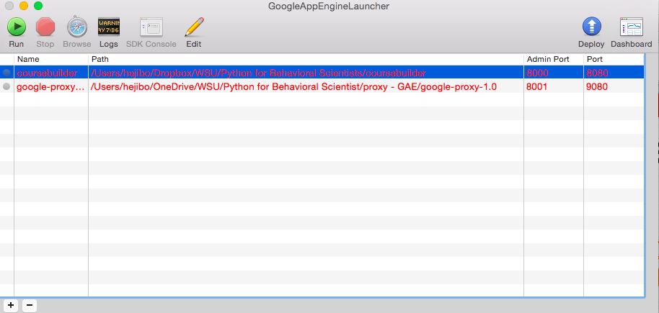
Setup GAE environment

Slide 9
Sign up GAE
Requirement:
- Have a Gmail account
Register link:
https://appengine.google.com

Slide 10
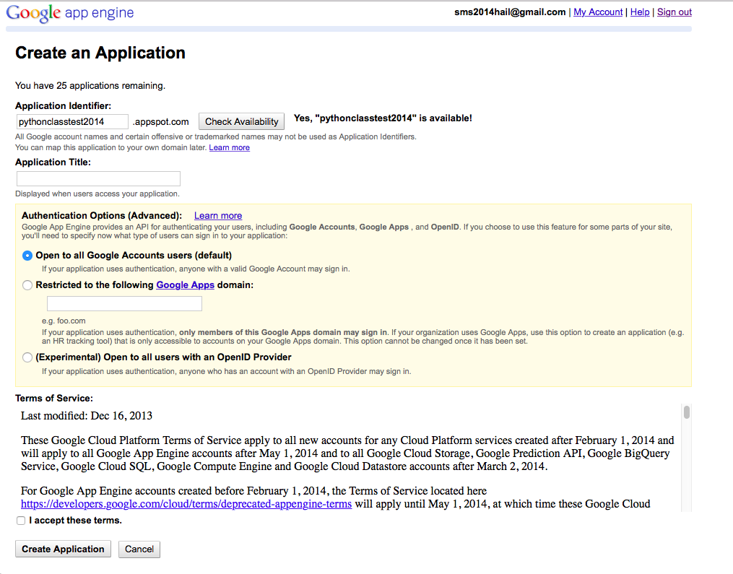
Create an application in GAE

Slide 11
Python SDK for GAE
https://cloud.google.com/appengine/docs/python/gettingstartedpython27/helloworld

Slide 12
Sign up GAE
Python SDK for GAE
https://cloud.google.com/appengine/docs/python/gettingstartedpython27/helloworld

Slide 13
Creating the Configuration File
application: useeglass
version: 1
runtime: python27
api_version: 1
threadsafe: true
handlers:
- url: /(.*\.(html))
static_files: static/HTML/\1
upload: static/HTML/(.*\.(html))

Slide 14

UPLOAD! HOORAY!

Slide 15
Thank You

